Slide 1
Computer graphics III – Path tracing
Jaroslav Křivánek, MFF UK
Jaroslav.Krivanek@mff.cuni.cz

Slide 2
Tracing paths from the camera
renderImage()
{
for all pixels
{
Color pixelColor = (0,0,0);
for k = 1 to N
{
ω_{k} := random direction through the pixel
pixelColor += getLi(camPos, ω_{k})
}
pixelColor /= N;
writePixel(pixelColor);
}
}

Slide 3
Path tracing, v. 0.1 (recursive form)
getLi (x, ω):
y = nearestIntersect (x, ω)
return
getLe(y, –ω) + // emitted radiance
getLr (y, –ω) // reflected radiance
getLr(x, ω_{inc}):
[ω_{gen}, pdf_{gen}] = genRndDirBrdfIs(ω_{inc}, normal(x) )
return
1/pdf_{gen} * getLi(x, ω_{gen}) * brdf(x, ω_{inc}, ω_{gen}) * dot(normal(x), ω_{gen})

Slide 4
Path Tracing – Loop version
getLi(x, wo)
{
Spectrum throughput = (1,1,1)
Spectrum accum = (0,0,0)
while(1)
{
hit = nearestIntersect(x, wo)
if no intersection
return accum + throughput * bgRadiance(x, wo)
if isOnLightSource(hit)
accum += thrput * getLe(hit.pos, -wo)
[wi, pdf(wi)] := SampleDir(hit)
Spectrum tputUpdate = 1/pdf(wi) * fr(hit.pos, wi, -wo) * dot(hit.n, wi)
survivalProb = min(1, tputUpdate.maxComponent)
if rand() < survivalProb // russian roulette – survive (reflect)
thrput *= tputUpdate / survivalProb
x := hit.pos
wo := wi
else // terminate path
break;
}
return accum;
}

Slide 5
Path termination – Russian roulette
getLi(x, wo)
{
Spectrum throughput = (1,1,1)
Spectrum accum = (0,0,0)
while(1)
{
hit = nearestIntersect(x, wo)
if no intersection
return accum + throughput * bgRadiance(x, wo)
if isOnLightSource(hit)
accum += thrput * getLe(hit.pos, -wo)
[wi, pdf(wi)] := SampleDir(hit)
Spectrum tputUpdate = 1/pdf(wi) * fr(hit.pos, wi, -wo) * dot(hit.n, wi)
survivalProb = min(1, tputUpdate.maxComponent)
if rand() < survivalProb // russian roulette – survive (reflect)
thrput *= tputUpdate / survivalProb
x := hit.pos
wo := wi
else // terminate path
break;
}
return accum;
}

Slide 6
Terminating paths – Russian roulette
Continue the path with probability q
Multiply weight (throughput) of surviving paths by 1 / q
RR is unbiased!

Slide 7
Survival probability – How to set it?
It makes sense to use the surface reflectivity ρ as the survival probability
If the surface reflects only 30% of energy, we continue with the probability of 30%. That’s in line with what happens in reality.
What if we cannot calculate ρ? Then there’s a convenient alternative, which in fact works even better:
First sample a random direction ω_{i} according to p(ω_{i})
Use the sampled ω_{i} it to calculate the survival probability as

Slide 8
Adjoint-drive RR and splitting
Vorba and Křivánek. Adjoint-Driven Russian Roulette and Splitting in Light Transport Simulation. ACM SIGGRAPH 2016

Slide 9
Direction sampling
getLi(x, wo)
{
Spectrum throughput = (1,1,1)
Spectrum accum = (0,0,0)
while(1)
{
hit = nearestIntersect(x, wo)
if no intersection
return accum + throughput * bgRadiance(x, wo)
if isOnLightSource(hit)
accum += thrput * getLe(hit.pos, -wo)
[wi, pdf(wi)] := SampleDir(hit)
Spectrum tputUpdate = 1/pdf(wi) * fr(hit.pos, wi, -wo) * dot(hit.n, wi)
survivalProb = min(1, tputUpdate.maxComponent)
if rand() < survivalProb // russian roulette – survive (reflect)
thrput *= tputUpdate / survivalProb
x := hit.pos
wo := wi
else // terminate path
break;
}
return accum;
}

Slide 10
Direction sampling
We usually sample the direction ω_{i} from a pdf similar to
f_{r}(ω_{i}, ω_{o}) cos θ_{i}
Ideally, we would want to sample proportionally to the integrand itself L_{i}(ω_{i}) f_{r}(ω_{i}, ω_{o}) cos θ_{i}, but this is difficult, because we do not know L_{i} upfront. With some precomputation, it is possible to use a rough estimate of L_{i} for sampling [Jensen 95, Vorba et al. 2014], cf. “guiding”.

Slide 11
BRDF importance sampling
Let’s see what happens when the pdf is exactly proportional to f_{r}(ω_{i}, ω_{o}) cos θ_{i} ?
Normalization (recall that a pdf must integrate to 1)
The normalization factor is nothing but the reflectance ρ

Slide 12
BRDF IS in a path tracer
Throughput update for a general pdf
...
thrput *= fr(.) * dot(.) / ( ρ * p(wi) )
A pdf that is exactly proportional to BRDF * cos keeps the throughput constant because the different terms cancel out!
...
thrput *= 1
Physicists and nuclear engineers call this the “analog” simulation, because this is how real particles behave.

Slide 13
Path guiding
Vorba, Karlík, Šik, Ritschel, and Křivánek. On-line Learning of Parametric Mixture Models for Light Transport Simulation. ACM SIGGRAPH 2014

Slide 14
Path guiding
Vorba, Karlík, Šik, Ritschel, and Křivánek. On-line Learning of Parametric Mixture Models for Light Transport Simulation. ACM SIGGRAPH 2014

Slide 15
Direct illumination calculation in a path tracer

Slide 16
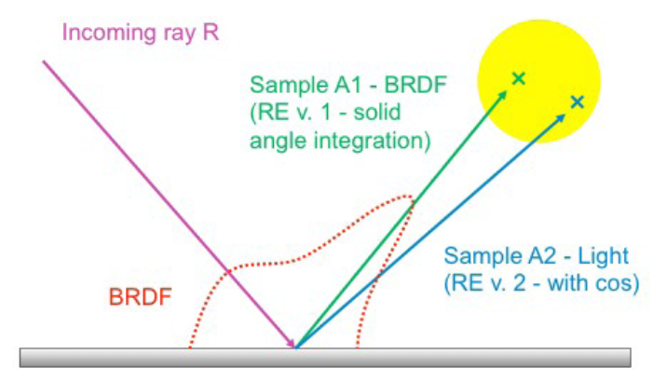
Direct illumination: Two strategies
At each path vertex x, we are calculating direct illumination
i.e. radiance reflected from a point x on a surface exclusively due to the light coming directly from the sources
Two sampling strategies
BRDF-proportional sampling
Light source area sampling
Image: Alexander Wilkie

Slide 17
The use of MIS in a path tracer
For each path vertex:
Generate an explicit shadow ray for the techniques p_{b} (light source area sampling – a.k.a. “next event estimation”)
Secondary ray for technique p_{a} (BRDF sampling)
One ray can be shared for the calculation of both direct and indirect illumination
But the MIS weight is – of course – applied only on the direct term (indirect illumination is added unweighted because there is no second technique to calculate it)

Slide 18
Dealing with multiple light sources
Option 1:
Loop over all sources and send a shadow ray to each one
Option 2:
Choose one source at random (ideally with prob proportional to light contribution)
Sample illumination only on the chosen light, divide the result by the prob of picking that light
(Scales better with many sources but has higher variance per path)
Beware: The probability of choosing a light influences the sampling pds and therefore also the MIS weights.

Slide 19
Learning the lights’ contributions
Before (no learning)
Vévoda, Kondapaneni, Křivánek. Bayesian online regression for adaptive direct illumination sampling. ACM SIGGRAPH 2018

Slide 20
Learning the lights’ contributions
After (with learning)
Vévoda, Kondapaneni, Křivánek. Bayesian online regression for adaptive direct illumination sampling. ACM SIGGRAPH 2018

